Slide 2
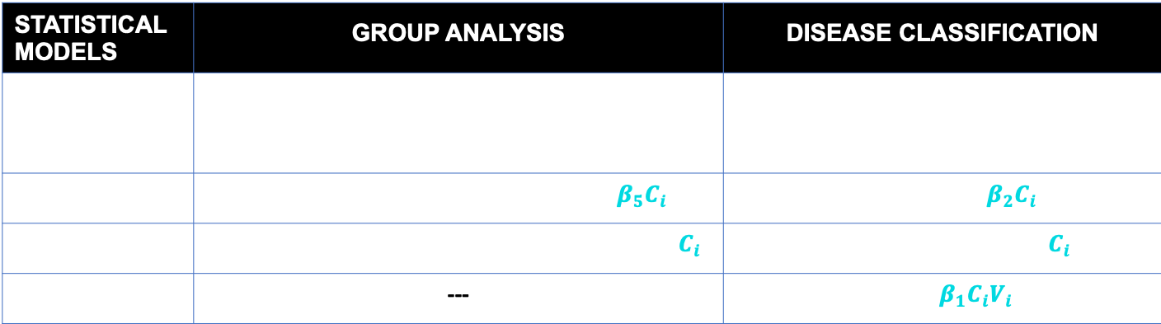
GROUP ANALYSIS
Post Analysis
STATISTICAL MODELS | GROUP ANALYSIS | DISEASE CLASSIFICATION
MANUAL BASE | $$V_{i}=β_{0}+β_{1}A_{i}+ β_{2}S_{i}+β_{3}B_{i}+β_{4}D_{i}+ε$$ | $$D_{i}=β_{0}+β_{1}V_{i}+ε$$
VARIABLE | $$V_{i}=β_{0}+β_{1}A_{i}+ β_{2}S_{i}+β_{3}B_{i}+β_{4}D_{i}+β_{5}C_{i}+ε$$ | $$D_{i}=β_{0}+β_{1}V_{i}+β_{2}C_{i}+ε$$
INSTANCE | $${[ V}_{i}=β_{0}+β_{1}A_{i}+ β_{2}S_{i}+β_{3}B_{i}+β_{4}D_{i}+ε ]∗C_{i}$$ | $${[ D}_{i}=β_{0}+β_{1}V_{i}+ε ]∗C_{i}$$
INTERACTION | --- | $$D_{i}=β_{0}+β_{1}C_{i}V_{i}+ε$$
2

Slide 3
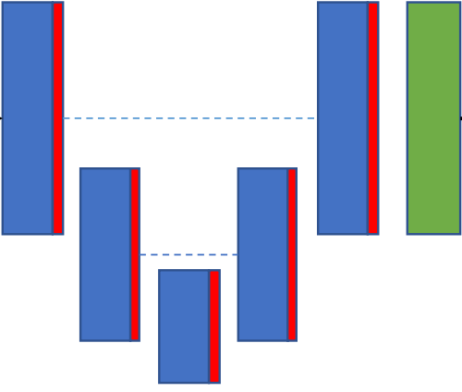
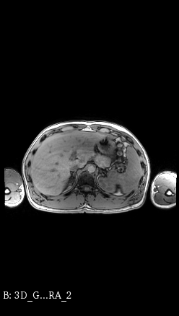
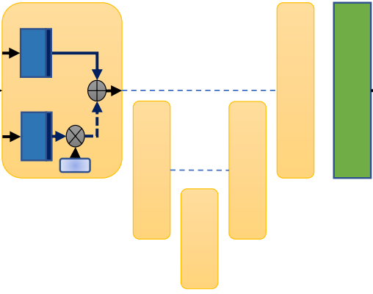
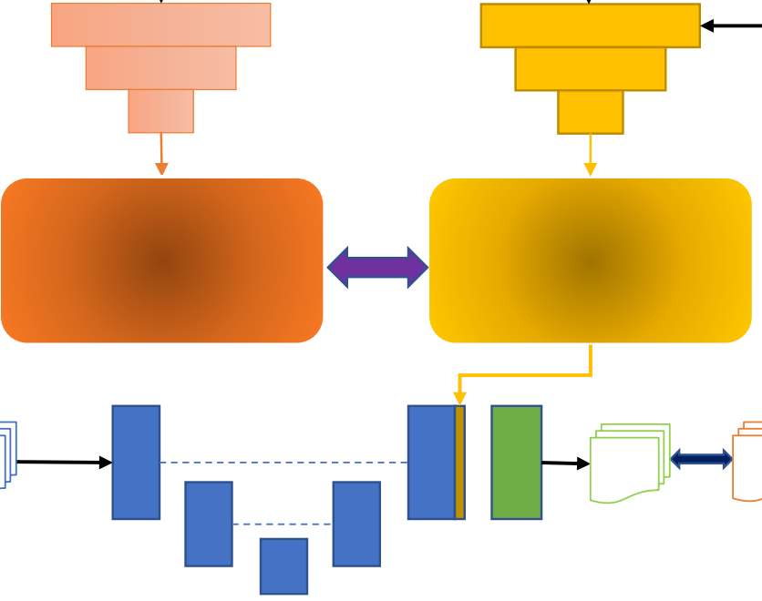
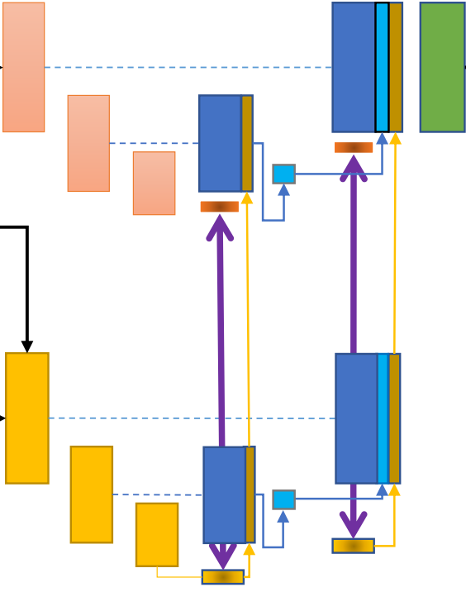

DATA PRE-PROCESSING
SEGMENTATION
AUTOMATED QUALITY CONTROL
POST-ANALYSIS
GROUP ANALYSIS
IoU
DISEASE
CLASSIFICATION
$${CV}^{−1}$$
...

Slide 4
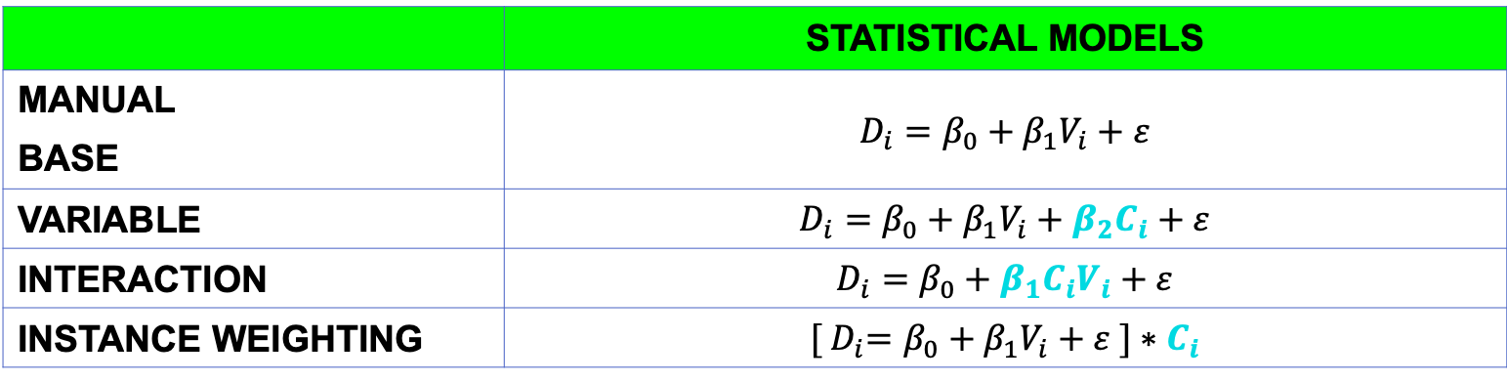
DISEASE CLASSIFICATION
Post Analysis
 | STATISTICAL MODELS
MANUAL BASE | $$D_{i}=β_{0}+β_{1}V_{i}+ε$$
VARIABLE | $$D_{i}=β_{0}+β_{1}V_{i}+β_{2}C_{i}+ε$$
INTERACTION | $$D_{i}=β_{0}+β_{1}C_{i}V_{i}+ε$$
INSTANCE WEIGHTING | $${[ D}_{i}=β_{0}+β_{1}V_{i}+ε ]∗C_{i}$$
4

